Slide 1
Conditional & Looping Statements…
Siva Sai Ganesh Sunkara…

Slide 2
CONDITIONAL STATEMENTS….

Slide 3
It is used to block of Statements based on given condition/Boolean Expression.
It is also called as selectional algorithm.
1. Sequential .
2. Selectional.
3. Iterational.
Above all are Algorithm types.
“if “ is called conditional / decision making / branching statement.
Types of “if” statements:-
1. simple if.
2. if – else.
3. if ---elif ladder.
4. nested if.

Slide 4
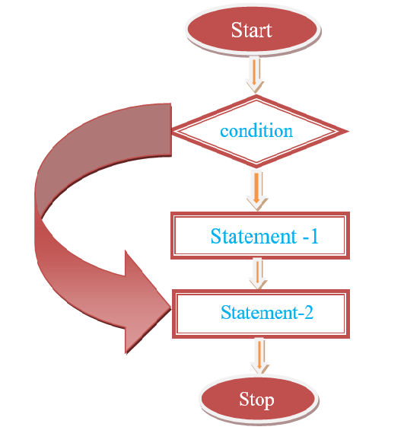
Simple if:-
→ if <condition> is true, it execute Statement-1 Statement-2, Statement-3.
→ if <condition> is false the it execute statement-3.
If without else is called is simple if.
This syntax is having only True block.
Syntax:-
if <condition>:
statement-1
statement-2
statement-3

Slide 5
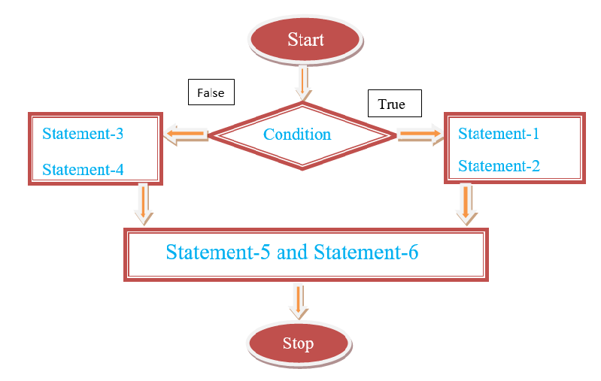
if –else:-
→This syntax is having 2 blocks
1. True – block. / if block
2. False – block. / else block
→ if conditional is “True”, it excute statement-1,2 and statement-5,6 .
→ if condition is “False” it excute statement-3,4 and continue with statement-5,6.
Syntax:-
if <condition>: → True block
statement-1
statement-2
else: → False block
statement-3
statement-4
statement-5
statement-6

Slide 6
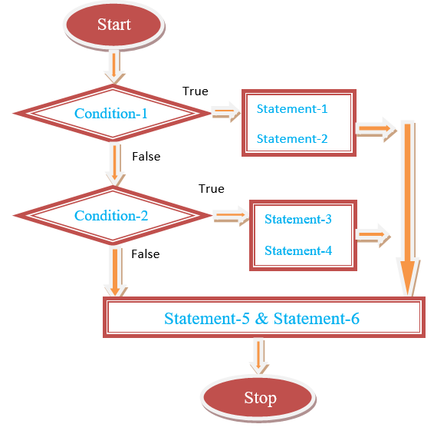
If….else ladder:-
→ checking multiple conditions using if….else ladder.
Syntax:-
if <condition-1>:
statement-1
statement-2
elif <condition-2>:
statement-3
statement-4
else:
statement-5
statement-6

Slide 7
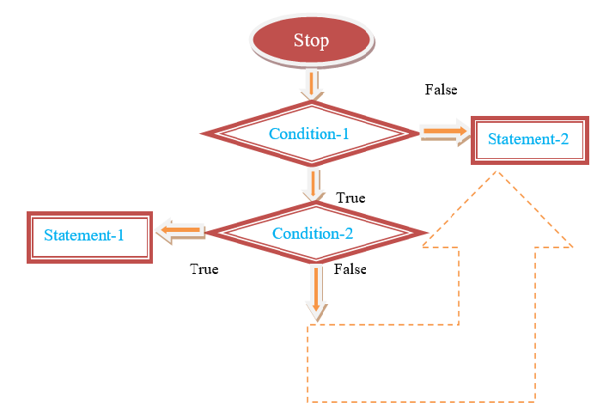
Nested-if:
→ If fallowed by another if is called Nested if (or) if within it is called Nested if.
Syntax:-
if <condition-1>:
if <condition-2>:
Statement-1
else:
statement-2
elif<condition-3>:
statement-3
else:
statement-4

Slide 8
LOOPING STATEMENTS….

Slide 9
Looping Statements to repeat one or more than one statement numbers of times or until given condition.
Python supports two types of looping statements.
1. While loop.
2. For loop.
Looping statements is also called as iterative statements…
Each looping statement has some syntax and some conditions are they.

Slide 10
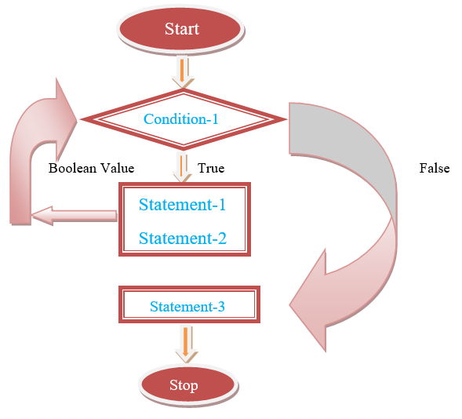
For loop:-
→ The for loop statement is used to translate over the element of a sequence (such as string, tuple (or) list) or other iterable object.
Syntax:-
1. for <variable –name> in <sequence>:
statement-1 2. for <variable –name> in <sequence>:
statement-2 statement-3
else: statement-4
statement-3
statement-4
statement-5

Slide 11
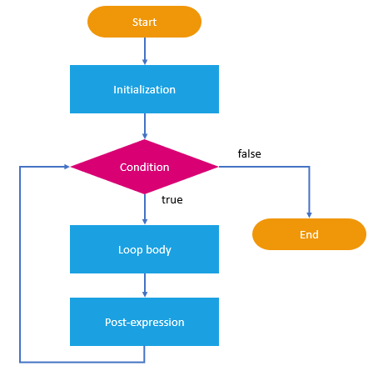
While loop:-
→While statement is used as for repeated Execution as long as an
Expression is TRUE.
Syntax:-
1. while <expression>: 2. while <expression>:
statement-1 statement-1
statement-2 statement-2
statement-3 else:
statement-3
statement-4
statement-5
→Initialisation statement which define initial value of condition/Expression.
→Expression/condition which define how many times the loop has to be executed.
→Updated statement which updates condition.

Slide 12
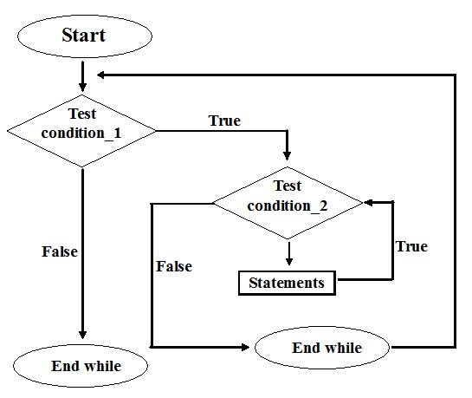
Nested while loop statement:-
→ while loop inside a while loop is called nested while.
Syntax:-
while <condition-1>:
while <condition-2>:
statement-1
statement-2
statement-3
statement-4
statement-5

Slide 13
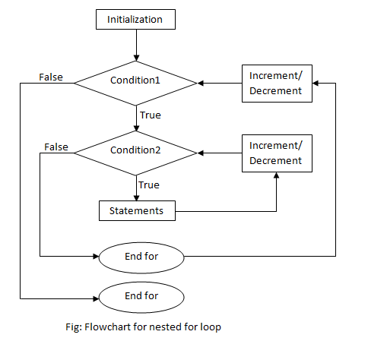
Nested for-loop:-
→ for loop inside for loop is called nested for.
Syntax:-
for < variable-name> in <sequence>:
statement-1
for <variable –name> in <sequence>:
statement-2
statement-3

Slide 14
THANK YOU…..

